Slide 1
Cain Middle School
CLASS OF 2030
WELCOME TO 7TH GRADE

Slide 2

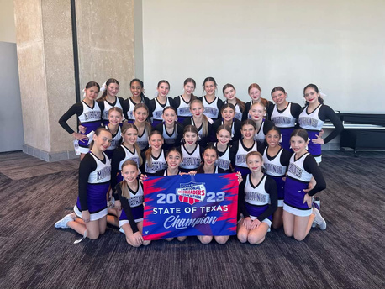
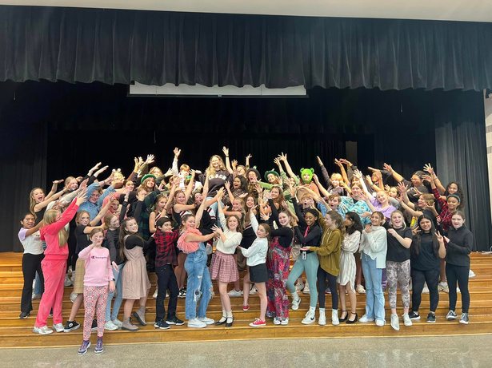

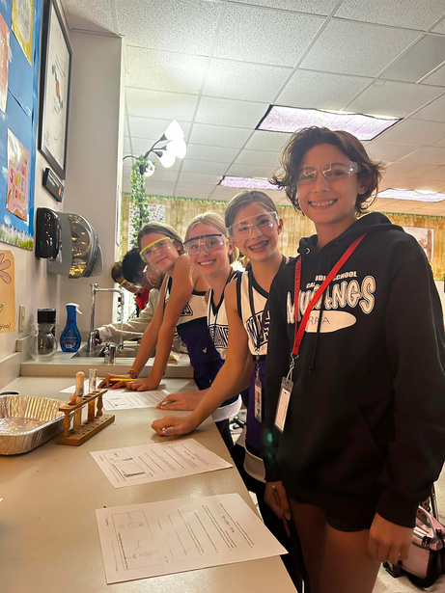
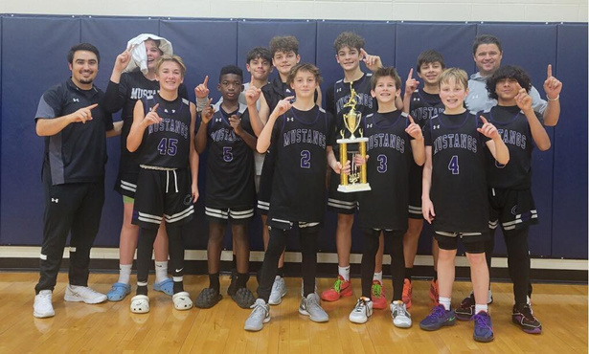
We are CMS Mustangs!

Slide 3

PRINCIPAL
Cain Leadership
Team
Mrs. Brittney Zabojnik
ASSISTANT PRINCIPALS
Mrs. Jori Butts (A-GL)
Mr. David Medina (GM-PA)
Mr. Reggie Webb (PB-Z)
COUNSELORS
Mrs. Carrie Batson (A-K)
Mrs. Maria Carroll (L-Z)

Slide 4
A Day in the Life of a CMS Mustang....
Presented by Cain PALS

Slide 5
Future Mustang Parent Night
JANUARY 24TH
6:00 - 8:00PM
Doors open at 5:45PM
SCHEDULE
Last Names Beginning with A-K
6:00 - 6:45 Presentation in Gym
6:45 - 7:45 In Cafeteria
Last Names Beginning with L-Z
6:00 - 6:45 In Cafeteria
7:00 - 7:45 Presentation in Gym
Parents Only Please!

Slide 6
English
  English
  Honors English (agreement required)
  SAGE English (must qualify)
Math
  Math
  Honors Math 7 (Compacted) (agreement required)
    Should be in Honors 6th Grade Math
    Must take Honors Science
Science
  Science
  Honors Science (Compacted) (agreement required)
    Must take Honors Math
  SAGE Science (must qualify)
Texas History
  Texas History
  Honors Texas History (agreement required)
Required Core Courses

Slide 7
  Students and parents MUST sign required agreement on the back of the Course Selection form before being placed into a Honors class
  You are making a year-long commitment to being in Honors
If you do not have the Honors Agreement signed then you will not be able to sign up for the Honors class.
Honors Courses

Slide 8
  Boys Athletics Football only
  Girls Athletics Volleyball and Basketball only
  Drill Team Try Out Required
  Cheer Team Try Out Required
  Boys Gymnastics Try Out Required
  Girls Gymnastics Try Out Required
  PE I
All classes (other than PE) require a physical each year!
Physical Education Credit
Required Class

Slide 9
  To start in Athletics, you MUST PLAY Football.
  Students who do not want to participate in Football will have an opportunity to try-out for Basketball when the Football season is over (schedules will be changed into athletics during the year).
  Tennis, Track, Cross Country, Wrestling and Soccer are before or after school - students DO NOT go into Athletics for these sports.
Boys Athletics
Boys Athletics Director
rickey.vanderburg@rockwallisd.org

Slide 10
  Girls Athletics is for girls wanting to tryout for Volleyball or Basketball Only.
    Volleyball Season is first
    Offseason occurs when you are not playing the sport currently in season
  Tennis, Track, Cross Country, Wrestling, and Soccer are before or after school - Students do not need to go into Athletics for these sports.
Girls Athletics Director
brittney.pike@rockwallisd.org
Girls Athletics

Slide 11
  The primary purpose of the cheer team is to learn the importance of teamwork and promote school spirit and pride.
Mandatory Parent Meeting - Tuesday, Feb. 20th
Tryout Clinic Day 1 - Wednesday, Feb. 28th
Tryout Clinic Day 2-4: M-W, March 4th-6th
Tryout Day - Thursday, March 7th
Coaches
brooke.smith@rockwallisd.org
caitlyn.miller@rockwallisd.org
Cheer Team

Slide 12
  The primary purpose of the drill team organization is to promote school spirit and pride while teaching teamwork and dance skills.
  Parent Meeting - February 28 at 6:30 at Cain
  Tryout Workshop - March 25 and 26 (4:30-6:30)
  Tryouts - March 27 at 4:00
Drill Team
DRILL TEAM DIRECTOR - CHRISTINA.FRANKLIN@ROCKWALLISD.ORG

Slide 13
  This course emphasizes the development of basic gymnastics skills, strength, and flexibility.
Gymnastics
Coaches:
Amy.Heidel@rockwallisd.org and James.Pershin@rockwallisd.org

Slide 14
  Circle 4 choices; You will write in a #1 and #2 for your top two choices. Do not write in your #3 or #4 choice.
  You will only get two out of your four choices.
  All Applications are found on the Cain Website under 7th Registration.
    If a class requires an application, you must submit it within the deadline or you will NOT be considered for that class
    Students must be logged in to their RISD Student Account to complete the application. They cannot be turned in using a parent email address.
Electives
We cannot guarantee any electives; they are determined by class numbers and availability.

Slide 15
  Art Studio 1 (7th grade only)
    Students will explore the fundamental concepts of art while developing a deep appreciation for various art forms.
  Advanced Art Studio 1 (7th grade only)
    Prerequisite: 6th grade art class and teacher recommendation; application required.
    Students will explore the fundamental concepts of art and learn visual literacy skills using critical thinking, imagination, and the senses to observe and explore the world by learning about, understanding, and applying the elements of art, principles of design, and expressive qualities.
Art Studio I and Advanced Art Studio I
Art Supplies Required - approximately $40 due at the beginning of Term 1.

Slide 16
  This course is an elective course that prepares identified students for college eligibility and success.
    Must take an Honors class.
    Prerequisite - Must be identified as an AVID student through an application and interview process.
AVID I
Advancement Via Individual Determination
AVID Coordinator - sterling.hapner@rockwallisd.org

Slide 17
  This course will describe and analyze musical sound and demonstrate musical artistry while performing a varied repertoire of music, individually and in groups.
    No experience needed.
    Multiple levels offered.
    Uniform and equipment fees apply.
Boys and Girls Choir
Choir Director -
mariah.moscoso@rockwallisd.org

Slide 18
  Must currently participate in a program in 6th grade OR
  Be new to the district and have some playing experience.
Band and/or Orchestra
Jim.Palmer@rockwallisd.org - Band
Amanda.Nelson@rockwallisd.org - Orchestra

Slide 19
  This course will provide a hands-on experience using industry standard software to film, edit, and broadcast videos.
  This class is primarily responsible for the final product of our daily school announcements.
    No experience needed.
    Application Required.
Broadcast I
jessica.butler@rockwallisd.org

Slide 20
  This course is a peer-tutoring/mentoring program that pairs seventh and eighth grade students with students needing peer academic and social (friendship) support.
    Prerequisite – Student application and interview
HOPE
(HELPING OUR PEERS EXCEL)

Slide 21
Robotics I
  This course is a lab-based course that uses a hands-on approach to introduce the basic concepts of robotics.
Robotics II
  This course requires students to participate in weekend competitions around DFW as well as some after school practices.
  Uniform and equipment fees apply.
    Application Required.
Investigating Careers in Robotics I and II
Kimberlea.Doss@rockwallisd.org

Slide 22
  This class focuses on news writing, basic photography and contributing to a campus newspaper.
Journalism I
Molly.Felfe@rockwallisd.org

Slide 23
Tech Apps
In this course students will participate in research, critical thinking, problem solving, decision making, digital citizenship, and technology operations and concepts.
One Semester of Each Class
Teen Leadership
The focus of this course is on the development of student character and vision so students will be prepared for the challenges of leadership while learning how to make good impressions, present ideas, become independent thinkers, work with difficult people, and seek personal excellence.
Technology Applications I and
Teen Leadership
Jenna.Grinnan@rockwallisd.org
.

Slide 24
Theatre Arts I
  Basic acting techniques are taught
    No experience required
Advanced Theatre Arts
  This course is a continuation of theatre techniques emphasizing stage performance.
  Additional practices/perfomances outside of the school day required.
    Application and Audition required.
Theatre Arts I
and Advanced Theatre
Lillian.Jones@rockwallisd.org

Slide 25
  Students will learn skills in planning, photography, word processing, page layout, graphic design, writing, and marketing to create the School Yearbook.
    Application required.
Yearbook I
kristine.worsham@rockwallisd.org

Slide 26
  Forms due to Homeroom Teacher on February 16 (with parent signature).
  All applications MUST be completed by Febraury 16th to be considered for a class that says Application Required. No exceptions! Applications are available on CMS Counseling Website, under the 7th Registration Tab or using the QR Code on the flyer.
  Honors Course Agreement (back of Course Selection Sheet) MUST be signed before a student will be placed into a Honors course.
3 Important Things

Slide 27
  Academic Planning Guide is on the right hand side. All class descriptions can be found there.
  All Applications can be found under 7th Grade Registration.
    Applications must be completed by STUDENTS using the RISD student login. Ask your Homeroom teacher for help.
Cain Middle School Website
Click the Counseling Tab.
All Registration Information can be found here, including a copy of this presentation.

Slide 28
Questions?

